Slide 1




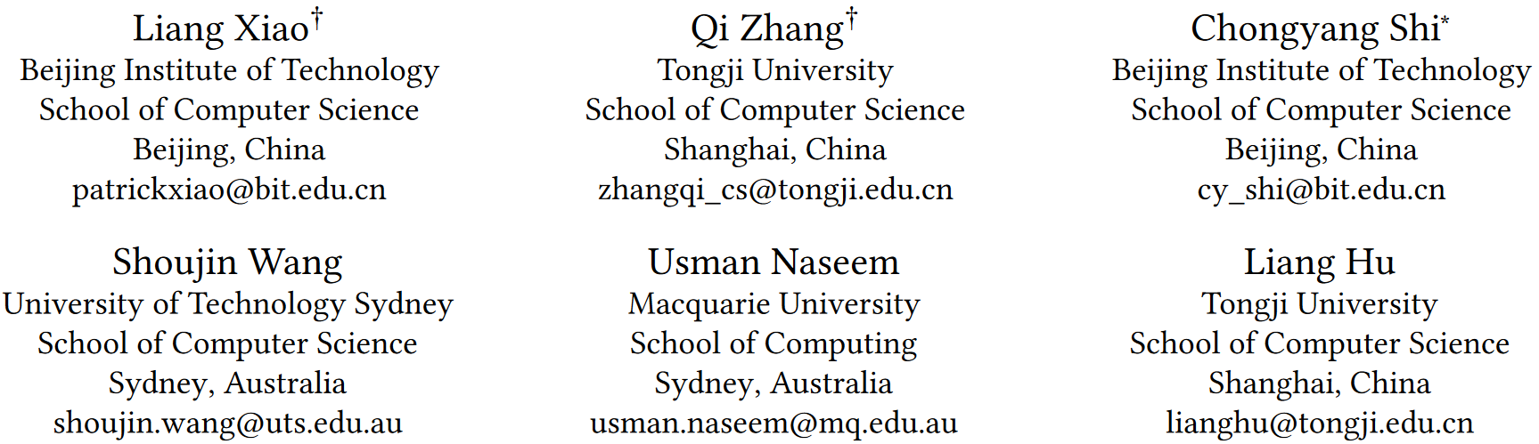





ATAI
Advanced Technique of Artificial Intelligence
ATAI
ChongqingUniversity _{AdvancedTechniqueof}
of Technology Artificial Intelligence
Chongqing University of Technology
Chongqing University ^{ATAI}
_{of Technology} Advanced Techniqueof
Artificial Intelligence
Chongqing University of Technology
Chongqing University of Technology
MSynFD: Multi-hop Syntax aware Fake News Detection
—— WWW ’24
Code:https://doi.org/10.5281/zenodo.10658674
Reported by ShuMing Jiang
1

Slide 2
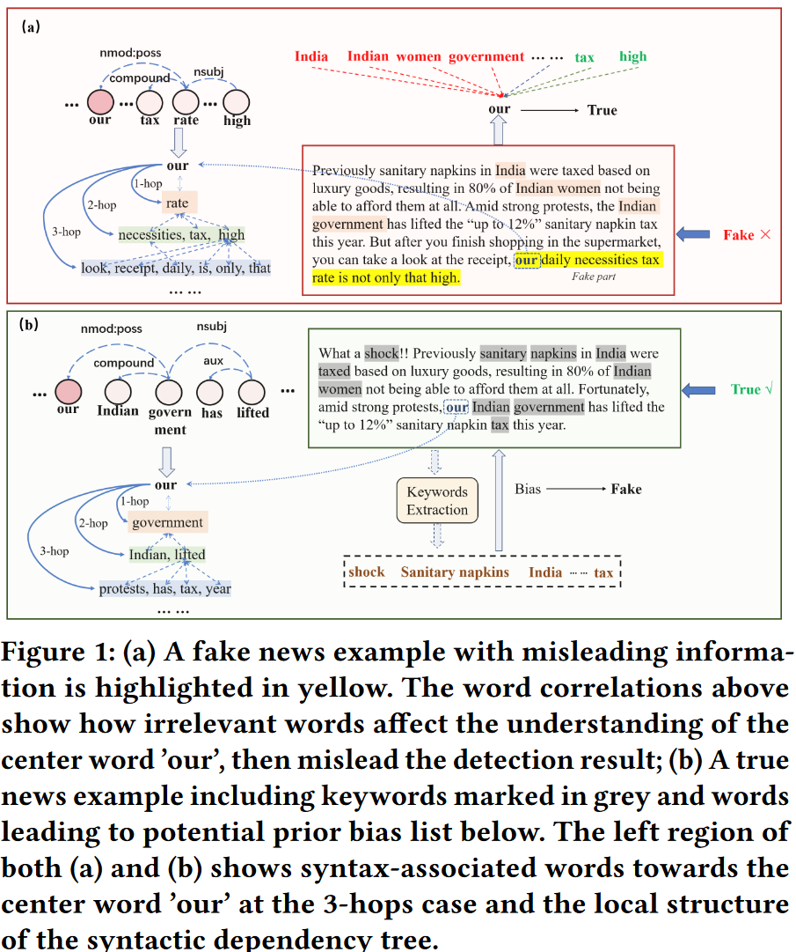
ATAI
Advanced Technique of
Artificial Intelligence
ATAI
ChongqingUniversity _{AdvancedTechniqueof}
of Technology Artificial Intelligence
Chongqing University of Technology
Motivation
(1)Previous methods heavily rely on sequential modeling and global attention to extract semantic information.
(2)The existing methods fail to handle the complex, subtle twists in news articles, such as referential transfer and prior biases.

Slide 3
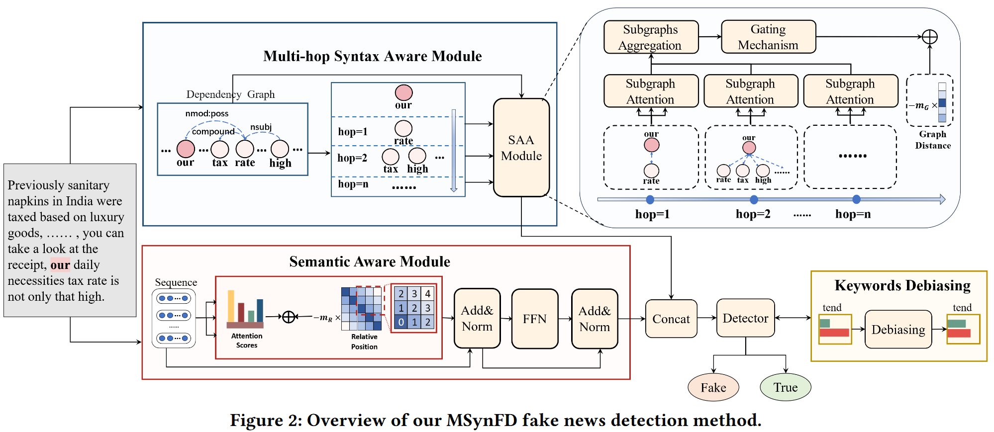
ATAI
Advanced Technique of
Artificial Intelligence
ATAI
ChongqingUniversity _{AdvancedTechniqueof}
of Technology Artificial Intelligence
Chongqing University of Technology
Overview

Slide 4
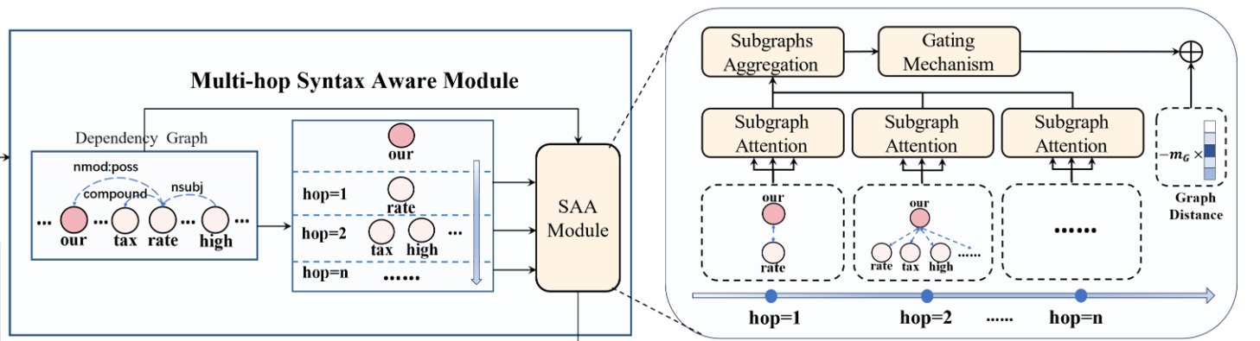
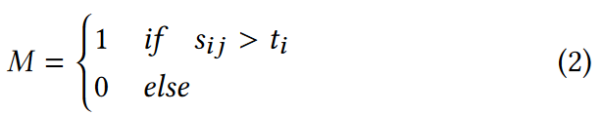
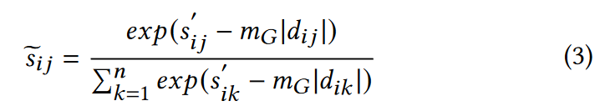
ATAI
Advanced Technique of
Artificial Intelligence
ATAI
ChongqingUniversity _{AdvancedTechniqueof}
of Technology Artificial Intelligence
Chongqing University of Technology
Method

Slide 5
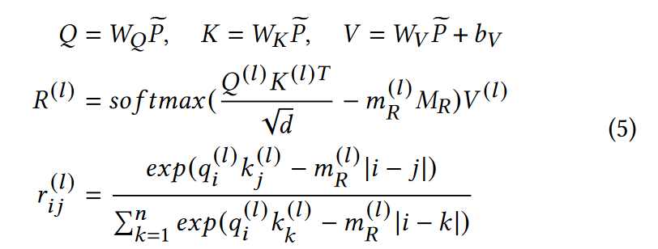
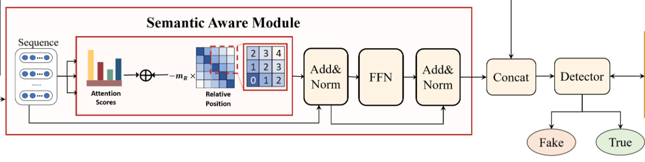
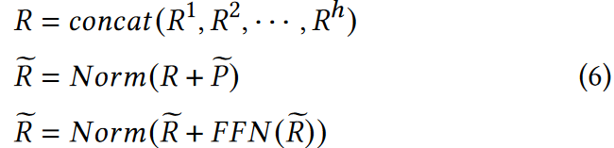
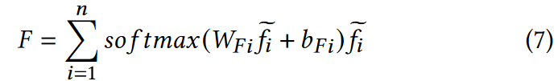
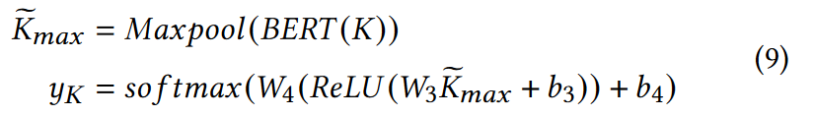
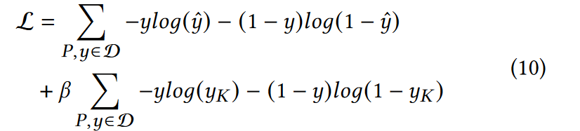
ATAI
Advanced Technique of
Artificial Intelligence
ATAI
ChongqingUniversity _{AdvancedTechniqueof}
of Technology Artificial Intelligence
Chongqing University of Technology
Method

Slide 6
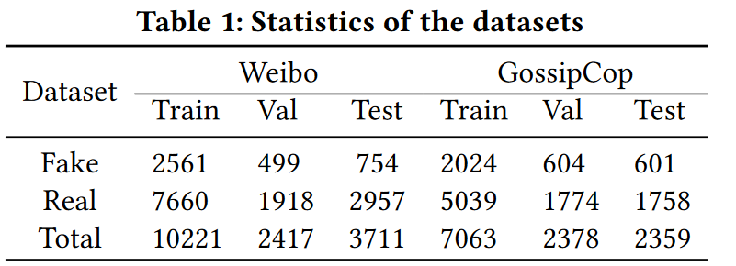
ATAI
Advanced Technique of
Artificial Intelligence
ATAI
ChongqingUniversity _{AdvancedTechniqueof}
of Technology Artificial Intelligence
Chongqing University of Technology
Experiments

Slide 7
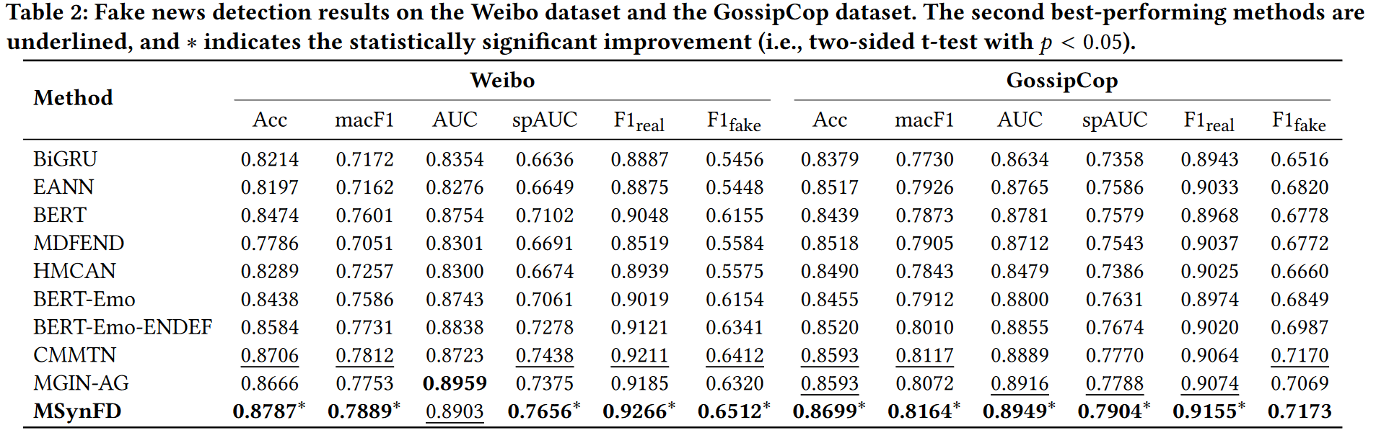
ATAI
Advanced Technique of
Artificial Intelligence
ATAI
ChongqingUniversity _{AdvancedTechniqueof}
of Technology Artificial Intelligence
Chongqing University of Technology
Experiments

Slide 8
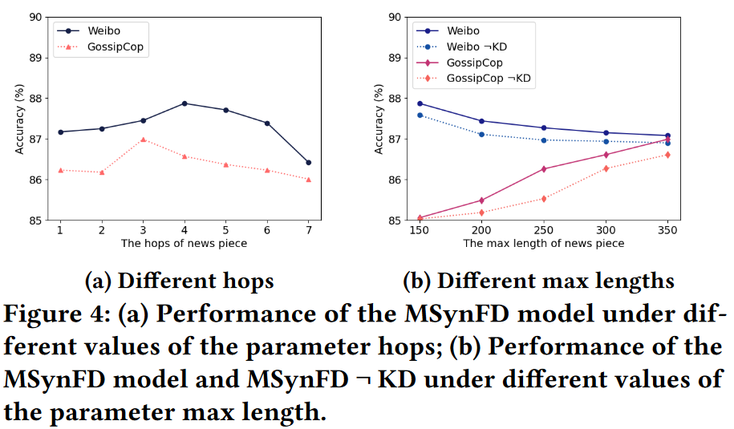
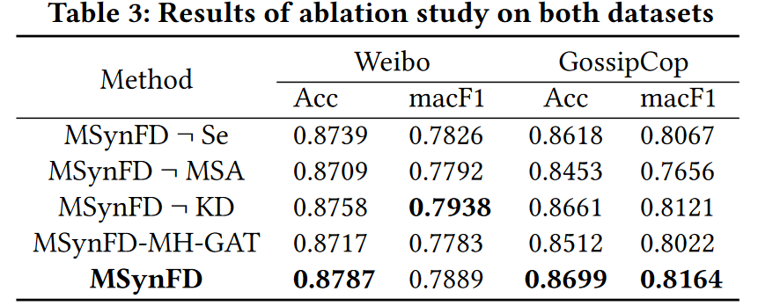
ATAI
Advanced Technique of
Artificial Intelligence
ATAI
ChongqingUniversity _{AdvancedTechniqueof}
of Technology Artificial Intelligence
Chongqing University of Technology
Experiments

Slide 9
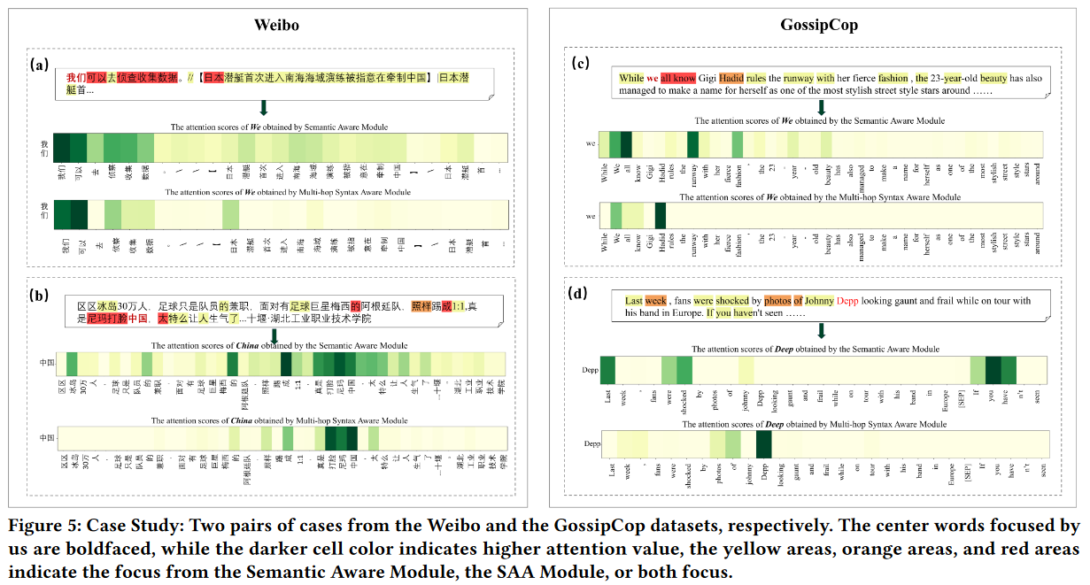
ATAI
Advanced Technique of
Artificial Intelligence
ATAI
ChongqingUniversity _{AdvancedTechniqueof}
of Technology Artificial Intelligence
Chongqing University of Technology
Experiments

Slide 10
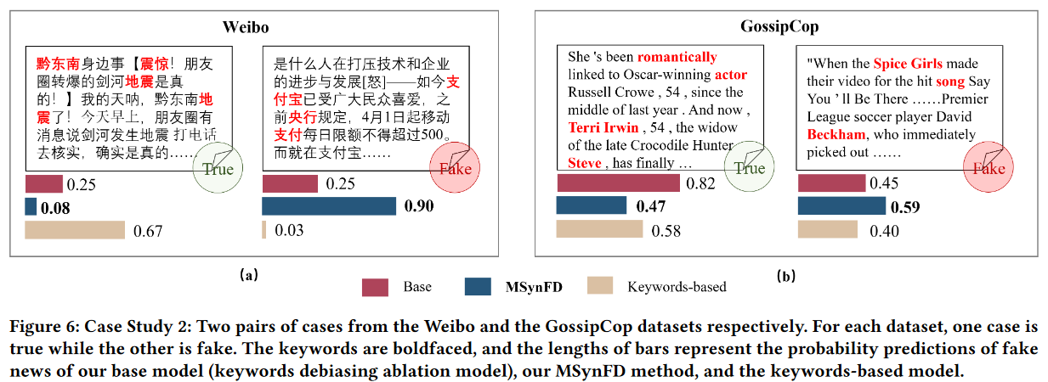
ATAI
Advanced Technique of
Artificial Intelligence
ATAI
ChongqingUniversity _{AdvancedTechniqueof}
of Technology Artificial Intelligence
Chongqing University of Technology
Experiments

Slide 11


ChongqingUniversity of Technology
ATAI
Advanced Technique of
Artificial Intelligence
ATAI
ChongqingUniversity _{AdvancedTechniqueof}
of Technology Artificial Intelligence
Chongqing University of Technology
Thanks!

